Slide 1

Optimizing Inventory Management and Supply Chain Efficiency to Minimize Dead Stock and Reduce Breakage
Submitted by:
Aditya Nupani
23f1000873

Slide 2
ORGANIZATION BACKGROUND
Spllatter is a Kolkata-based trading firm which specializes in high-quality crockery, cutlery, barware and serve ware.
It was started in 2022 by Ms. Kanupriya Agarwal.
It started out as a supplier to retailers and gradually expanded its client base to hotels, restaurants and resorts across the country. The mode of operation is B2B.
The company is facing problems related to accumulation of dead stock and breakage of goods during transportation.

Slide 3
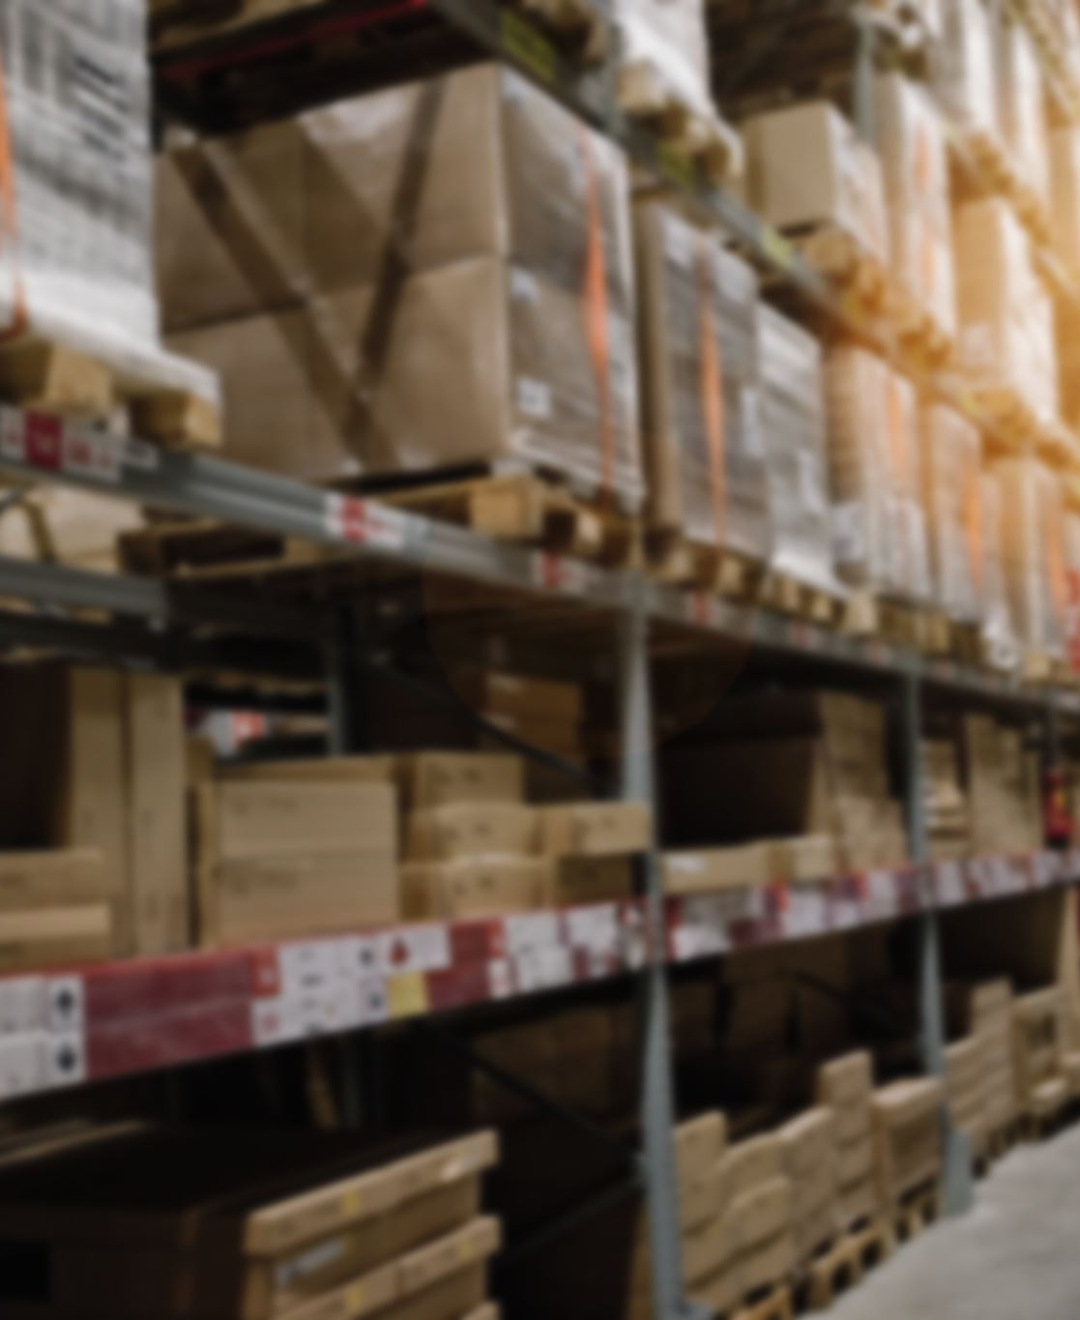
PROBLEM STATEMENTS
Minimize Inventory Dead Stock
Implement a demand-driven inventory management strategy
Analyze inventory levels and demand trends for design patterns throughout the year
Reduce overstocking and understocking of items
Reducing Product Breakage during Transportation
Enhance packaging and logistics practices
Minimize product damage during delivery and improve delivery reliability

Slide 4

DATA COLLECTION
Data Sources
Primary data collected from company including sales and purchase invoices for 5 months (July 2024 – November 2024).
Data extracted, structured and cleaned using Microsoft Excel 2021.
Debit/credit status for the year 2024 used to cross-validate transactions.
Key Datasets
IncomingGoodsBreakageAnalysis – Data on breakage of purchased goods (~30% breakage rate)
OutgoingGoodsBreakageAnalysis – Data on breakage of goods being delivered to client (~2% breakage rate)
DeadStockAnalysis – Sales data used for demand forecasting and ABC analysis

Slide 5


DATA ANALYSIS
Tools Used
Microsoft Excel 2021
Used for data cleaning, descriptive statistics and preliminary analysis with the help of pivot tables and built-in functions like SUM,SORT and FORECAST (included in Analysis Tool Pak add-in).
Python
Used for performing advanced analysis methods such as time series forecasting, demand variability and geospatial mapping by leveraging libraries like numpy, pandas, matplotlib and folium.
Data Cleaning and Preprocessing
Extracted from PDFs to Excel, removed duplicates and formatted currency
Used python (pandas, geopy) to standardize buyer locations
Analysis Methods
Time series analysis (python, statsmodels) -> Trend, seasonality and residuals extracted to predict demand.
ABC Analysis and Demand Variability Analysis -> Classified high-revenue products and identified products at risk of becoming dead stock
Geospatial Mapping and Route-wise Analysis -> Used folium and plotly to identify high breakage regions
Root-Cause Analysis –Fishbone Diagram) -> Identified key reasons for breakage of goods related to packaging, transportation and handling

Slide 6
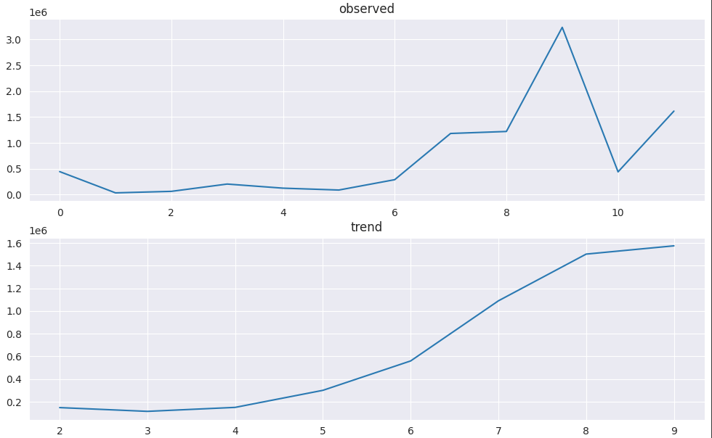

RESULTS AND FINDINGS
Time Series Analysis (Observed Sales Over Time) 📈
Shows sales peaking between July and October due to festival & wedding season.
Supports the need for preemptive stock replenishment in June.
ABC Analysis (Top Revenue-Contributing Products) 🔍
Category A: 86 SKUs contribute 60% of revenue.
Category B: 60 SKUs contribute 25% of revenue.
Category C: Remaining SKUs contribute 15% of revenue, many of which become dead stock.
Advanced Time Series Analysis
Result of ABC Analysis

Slide 7
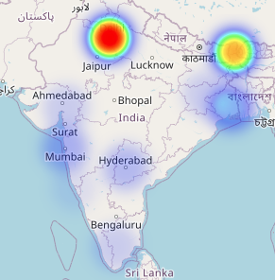
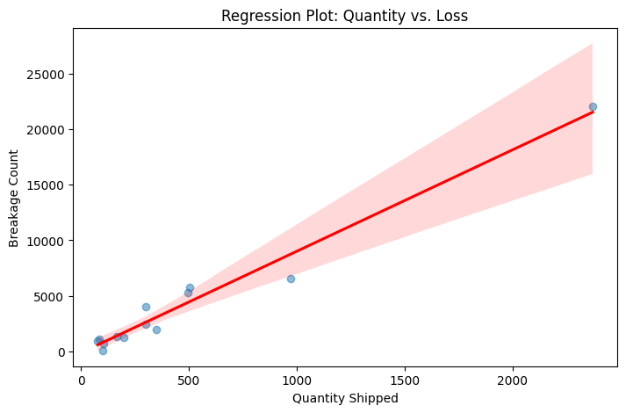
Geospatial Mapping (Heatmap of High Breakage Zones) 🌍
Northern & Western regions (Delhi, Maharashtra, Darjeeling) show higher breakage rates.
Contributing factors: rugged terrain, inefficient packaging, and poor transportation routes.
Regression Analysis (Breakage vs. Ordered Quantity) 📊
Higher order volumes correlate with increased breakage.
Suggests that improper bulk packaging increases damage risks.
Fishbone Diagram (Root Causes of Breakage) 🛠️
Identifies key factors: poor packaging, rough handling, environmental conditions, and logistics inefficiencies.
Geospatial Mapping

Slide 8
INTERPRETATION AND RECOMMENDATIONS
Sales Trend Insights
High sales from July to October, indicating a need for pre-season inventory stocking in June.
Sales variability suggests that some products have unpredictable demand, making just-in-time inventory management crucial.
Breakage Analysis Insights
Northern and western regions experience higher breakage rates due to transportation issues.
Orders with larger quantities face more breakage, highlighting bulk packaging flaws.

Slide 9
RECOMMENDATIONS
Inventory Optimization
Reduce SKUs with high variability to minimize dead stock.
Implement inventory tracking software to monitor real-time stock levels.
Prioritize stocking high-demand products before peak seasons.
Breakage Reduction Strategies
Improve packaging quality (use stronger cushioning materials for fragile items).
Explore alternative transportation (rail or air transport) for high-risk regions.
Implement a breakage log to track issues and refine packaging strategies.

Slide 10

THANK YOU
I would like to thank Dr. Ashwin J. Baliga, Dr. Aaditya Chandel and the TAs for guiding me throughout the course of this project.

